Slide 1
Activity 6: MORPHOLOGICAL OPERATIONS
Genesis Vertudez – 202003099
App Physics 157 - Computational Analysis and Modeling in Physics
Submitted to Dr. Maricor Soriano; Mx. Rene Principe Jr.

Slide 2
OBJECTIVES
Perform morphological operations manually on images given a structuring element
Verify the results numerically
Improve segmented images using morphological operations

Slide 3
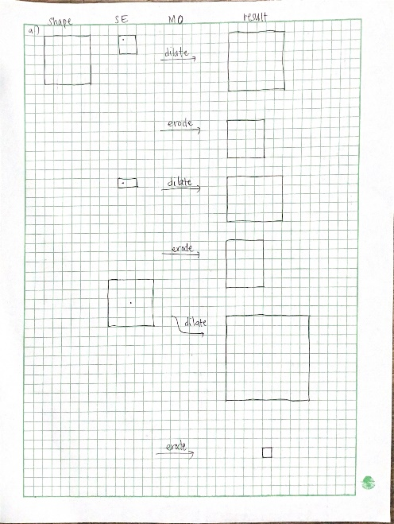
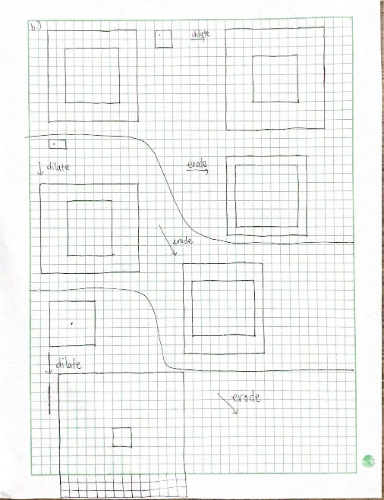
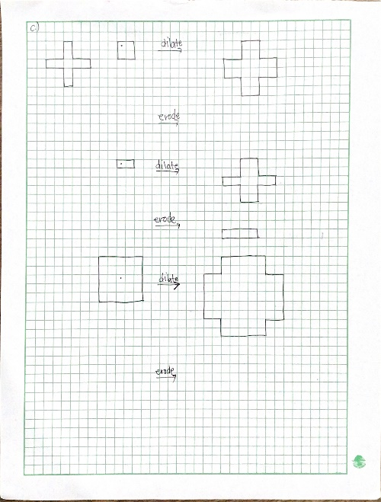
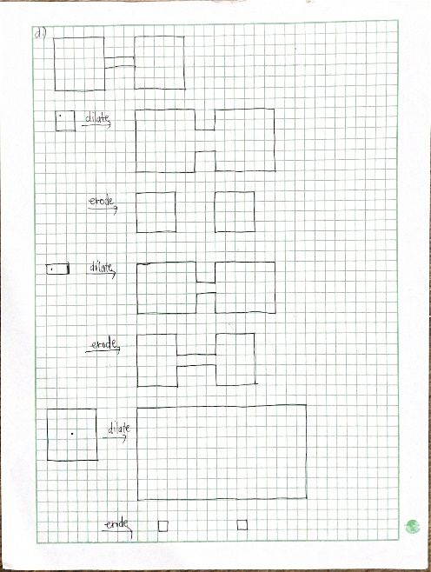
MORPHOLOGICAL OPERATIONS - MANUAL
Morphological operations are usually used on binary images of 0’s and 1’s where the 1’s constitute the image. As the name suggests, they are operations used to manipulate the morphology, or shape, of an image based on a given structuring element (SE). The common morphological operations include the dilation, erosion, opening (erode then dilate), and closing (dilate then erode) operation.
Before trying out the morphological operations available in Python, I tried mapping the results in a graphing paper. Dilation “extends” an image, while erosion “contracts” it. Dilation works by overlapping the origin of the SE over different pixels, and “turning on”, or switching that pixel to a 1 IF the image and the structuring element overlap even by one pixel. On the other hand, erosion works by again overlapping the origin of the SE over different pixels, and turning it on only when the SE is fully inside the image.
Solid square
Hollow square
Plus symbol
Dumbell
Codes and files: https://github.com/genvert/AP_157_FX-2_Vertudez/tree/main/Activity%207

Slide 4
REFLECTION
This activity was somewhat a breather since it was fun and easy to do!
It was nice to look back at Set Theory because I am fuzzy with it.
I really enjoyed the manual mapping of the morphological operations and drawing it on a graphing paper. It was fun to visualize how the structuring elements will affect the images.
Lastly, I found it satisfying when a noisy segmented image gets cleaned up using morphological operators.

Slide 5
SELF-GRADE
Technical correctness: 35/35
I am confident that I understood how to experiment with combinations of morphological operations in order to gets the best “cleaned” segmented image.
Quality of presentation: 35/35
I have explained each step and idea, and images are clear and concise.
Self-reflection: 30/30
The activity was really fun and easy. I only slacked because I was stuck in the previous activity and again my bad habit is not trying other things when I am stuck in a previous thing.
Initiative: 10/10
I went beyond the expected output by trying the image I used in ImageJ activity.

Slide 6
REFERENCES
[1] Soriano, M. (2023). AP 157 module. A6- Morphological operation 2023.
[2] https://www.youtube.com/watch?v=bRa770kRapc&pp=ygUsbW9ycGhvbG9naWNhbCBvcGVyYXRpb25zIGluIGltYWdlIHByb2Nlc3Npbmc%3D
[3] https://www.youtube.com/watch?v=d1we_yqUASg&t=640s&pp=ygUsbW9ycGhvbG9naWNhbCBvcGVyYXRpb25zIGluIGltYWdlIHByb2Nlc3Npbmc%3D
[4] https://www.youtube.com/watch?v=2LAooUu1IjQ&pp=ygUsbW9ycGhvbG9naWNhbCBvcGVyYXRpb25zIGluIGltYWdlIHByb2Nlc3Npbmc%3D

